Slide 1


Introduction to ROS2
Abboud Hayek

Slide 2

Agenda
Personal profile
Introduction to ROS2
Basic concepts ( topics, nodes, publishers...)
Demo

Slide 3
Personal profile

Slide 4

Life and Career
5th year Computer Engineering student at the Lebanese Amercian University
Former BMW Computer vision and simulation intern in the Tech Office, Munich

Slide 5
Motivation for ROS2
Started with a research conducted in the university focusing on Human Robot Interaction.
ROS is the perfect tool to be used in our research.
Learned it from scratch through "The Construct" and afterwards applied it.

Slide 6
Introduction to ROS2

Slide 7
What is ROS2?
Framework, not an OS : ROS2 is a middleware or framework, not an actual operating system.
Successor to ROS1: It's the next version of ROS1, built on the same core concepts but more advanced.
Development Tools: Offers tools for faster robot development such as logging and 3D visualization.
Plugins: Includes third-party plugins with ready-to-use functionalities.
Community: Supported by an open-source community focused on robotics projects.
Distributed Applications: Provides a structure for creating distributed robotics applications with inter-communicating parts.

Slide 8
Different use cases and applications
Education & Research: Utilized in academic settings for robotics education and cutting-edge research.
Product Development: Employed in the development and deployment of commercial robotics products.

Slide 9
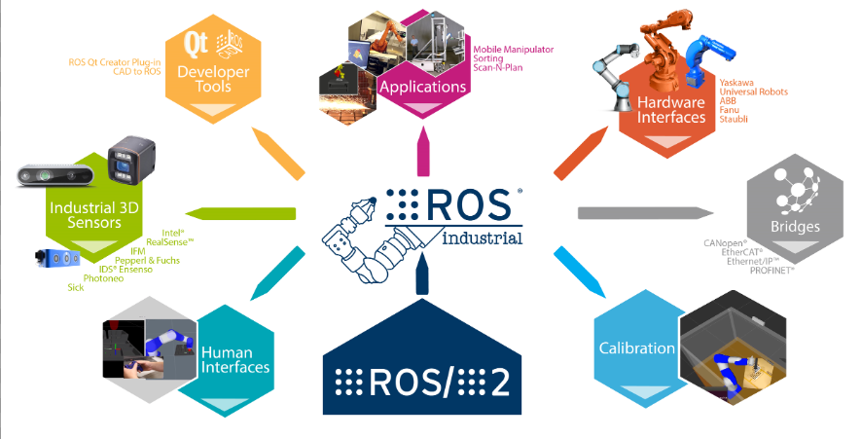

Slide 10
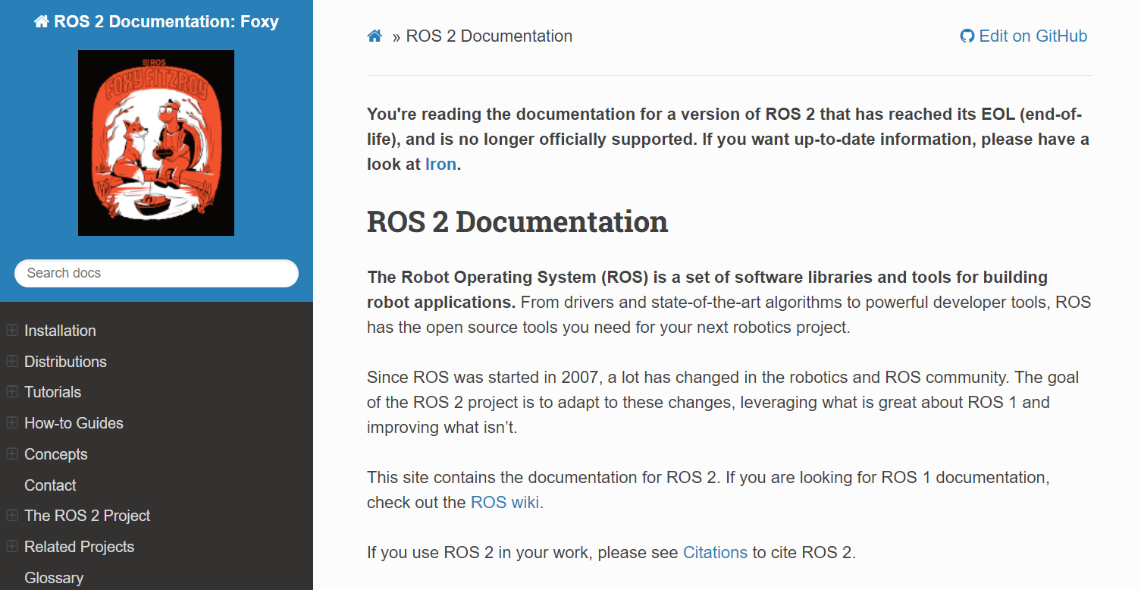
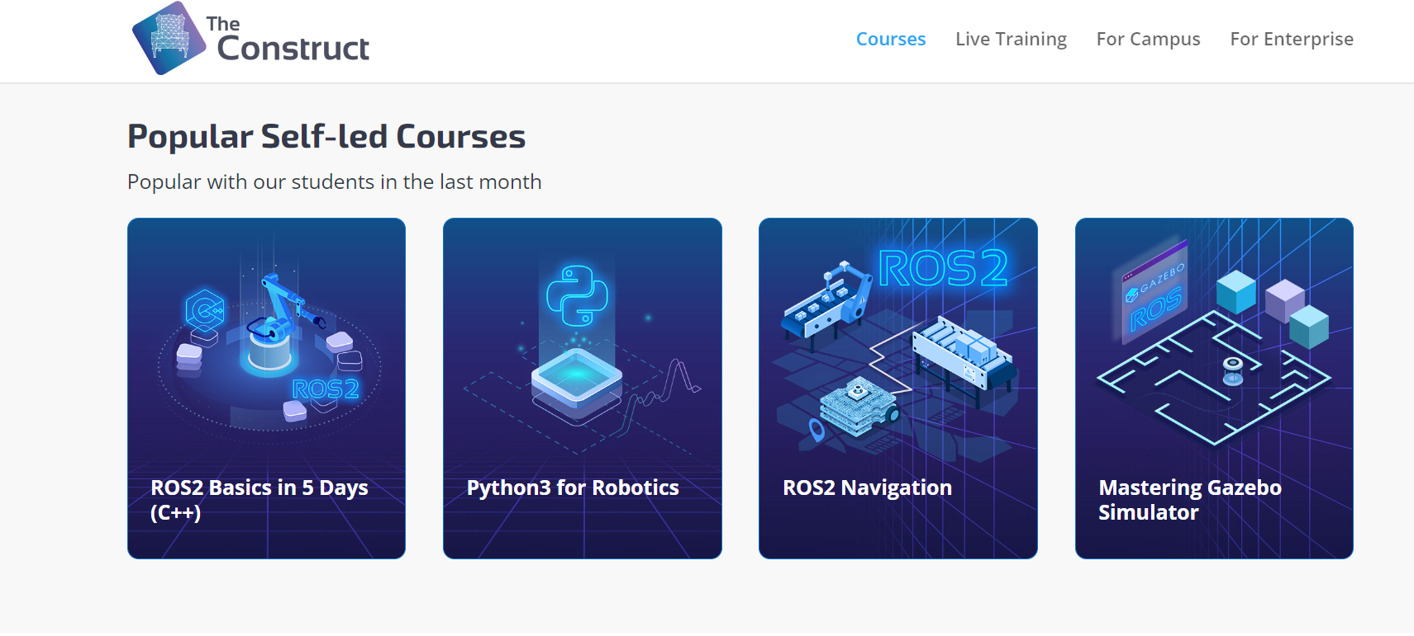
Documentation and community

Slide 11
Basic concepts

Slide 12
Packages
Packages in ROS2 serve as organizational units for code, making it easier to install and share with others.
A ROS2 package typically includes a CMakeLists.txt file, a package.xml for metadata, a src directory for source code, and directories for public headers and resources.
Multiple packages can reside in a single workspace, each in separate folders to maintain a clean environment. Packages of different build types (e.g., CMake, Python) can coexist within one workspace .

Slide 13
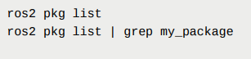
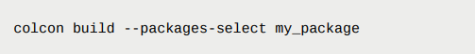
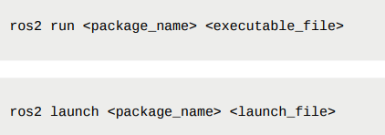
Important commands
Create a package
List all packages
Build a package
Launch a package

Slide 14
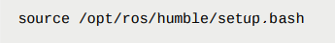
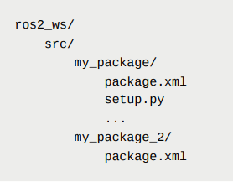
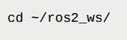
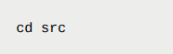
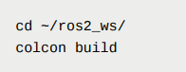
Steps to create and build a package
1
2
3
4
5

Slide 15
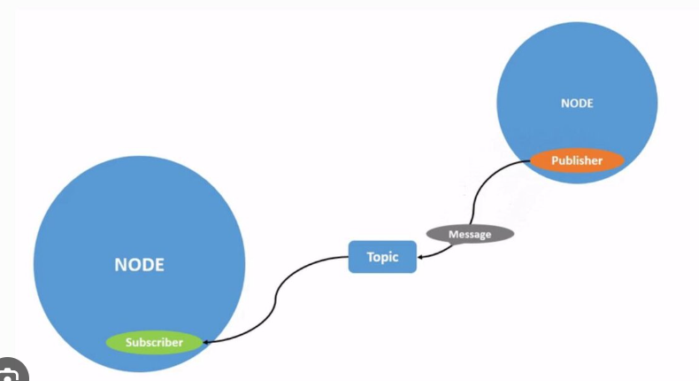
Nodes
Nodes are the primary units of communication within the ROS2 graph, interacting with other nodes.
Each node should ideally perform one logical task within the ROS system.
Nodes can publish data to topics or subscribe to topics to receive data.
They can act as service clients to request computations or as service servers to provide services.

Slide 16
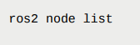
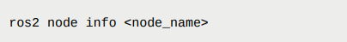
Important commands
Listing all nodes
Getting information about a specific node

Slide 17
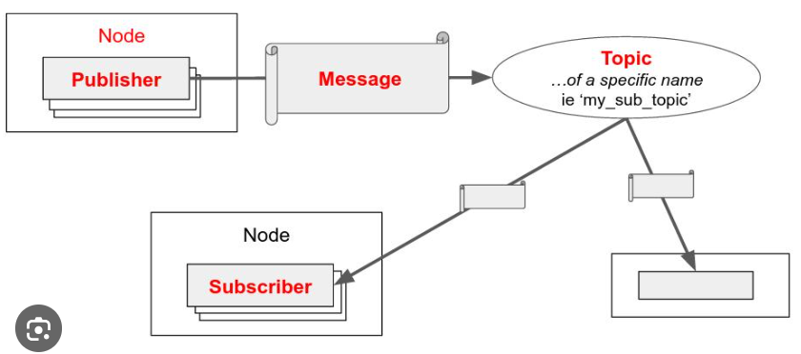
Topics
Allows nodes to produce (publish) or consume (subscribe) data using a common identifier known as a "topic".
Subscribers don't need to know which publisher sent the data, allowing flexibility in swapping publishers and subscribers.
Enforces data types in messages and adheres to well-defined semantics for message fields.

Slide 18

Interfaces
Interfaces in ROS2 serve as the communication protocols between different parts of a ROS application
Messages (.msg files): Define data structures for sending data over the network, with no response expected from the receiver.
Services (.srv files): Describe a pair of message structures for service requests and responses between nodes.
Actions (.action files): Specify a trio of message structures that encompass a goal, result, and feedback for longer-running interactions between nodes.

Slide 19
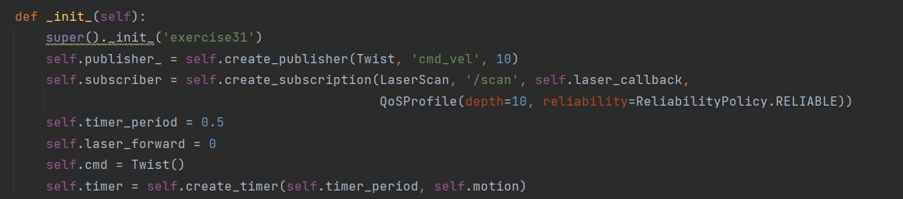
Initialize Publisher & Subscriber

Slide 20
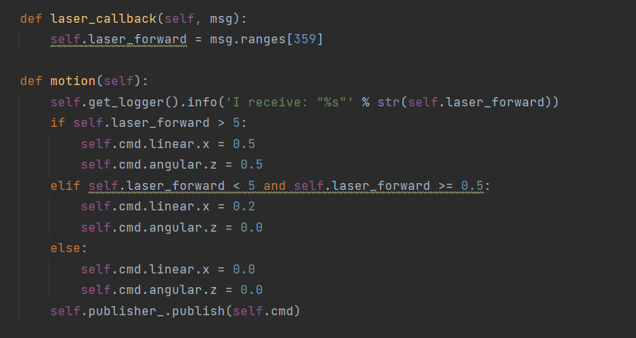

Slide 21
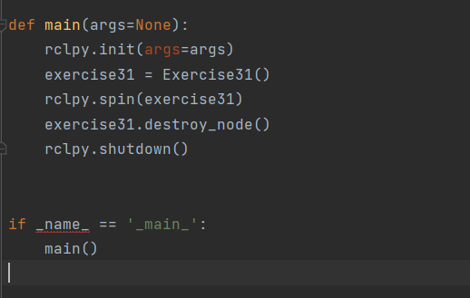
Run main function

Slide 22
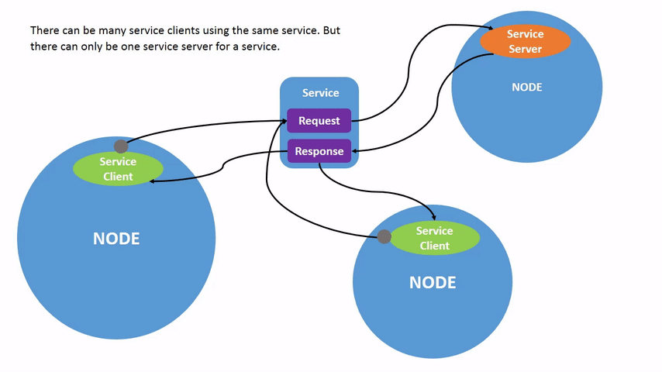
Services
Synchronous or asynchronous communication method between nodes.
Composed of Service Servers and Service Clients.
Utilizes service messages defined in .srv files for structured requests and responses.

Slide 23
Service Servers in ROS2
Service Servers provide specific functionalities that can be requested by clients.
They are created within nodes and listen for incoming service requests.
Servers process requests and send back responses, either synchronously or asynchronously.

Slide 24
Service Clients in ROS2
Service Clients request services from servers using the service type and name.
Clients can wait for the server to process the request and return a response (synchronous) or proceed with other tasks and handle the response later (asynchronous).

Slide 25
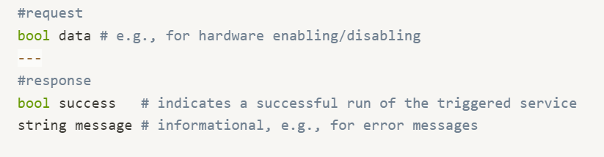
Defining Service Messages
Service messages are specified in .srv files within a package.
Each .srv file is divided into two parts: request and response.
The structure of these messages determines the data exchanged between clients and servers.

Slide 26
Creating a Service Server
Define a service type (.srv file) and build the package.
1
Implement a service callback function to process requests.
2
Advertise the service with a unique service name and decide on synchronous or asynchronous handling.
3

Slide 27
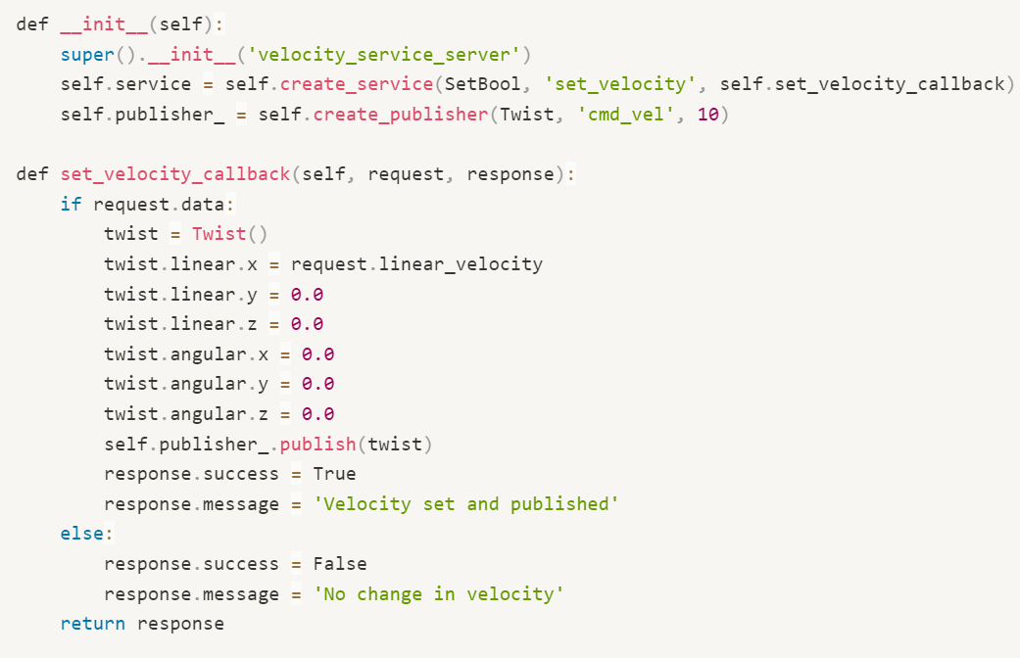
Service Server

Slide 28
Creating a Service Client
1- Instantiate a client node that uses the service type and name to call the service.
2- Implement logic to send a request and handle the response, choosing between synchronous or asynchronous communication.

Slide 29
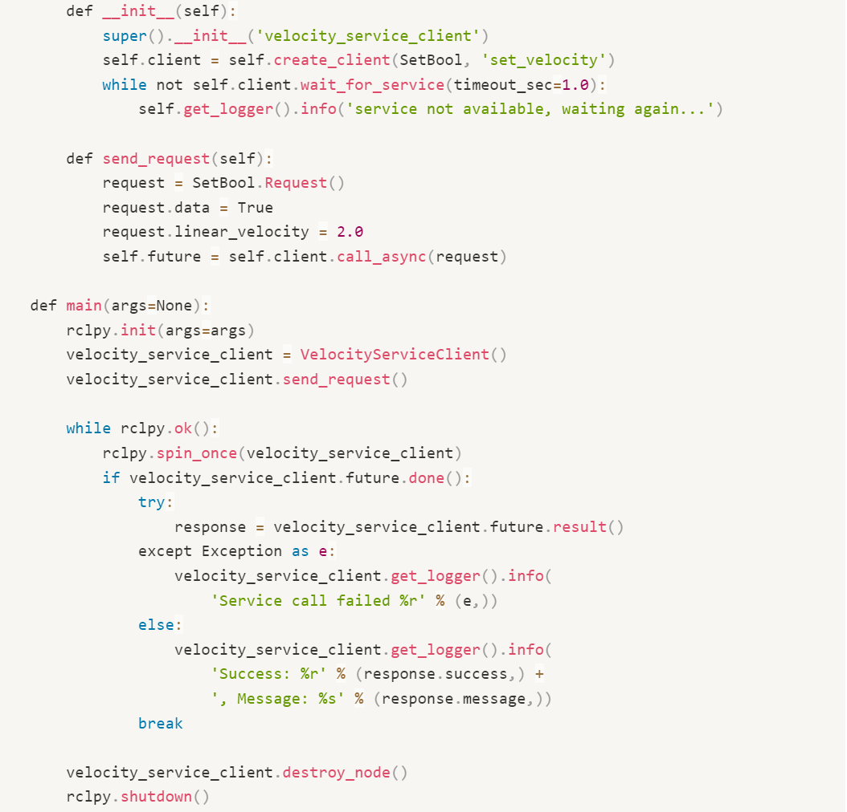
Service Client

Slide 30
MAIN DEMO

